Slide 1
NLPs prototype
LLM 및 Hardware 선정
2024.08.00

Slide 2
진행 순서
선정 LLM, GPU, Hardware
LLM 선정 근거
GPU 선정 근거
Hardware 선정 근거

Slide 3


선정 LLM, Hardware
Hardware
품명 | 수량 | 가격 (백만원)
ASUS ESC4000-E11 2U 4GPU SERVER | 1 | 68
Xeon Silver 4516Y+ (24Core, 2.2GHz) | 2
32G DDR5 RDIMM | 16
Samsung SSD PM893 1.92TB, 2.5in | 2
NVIDIA Ada L40S 48GB GDDR6 PCIe | 4
ASUS L40S, H100, 4080 power cable | 4
RAID Broadcom 9361-8i(1G) | 1
MinisasHD to SlimsasX4 cable(100cm) | 1
NIC Intel® X710-DA4 FH | 1
Ethernet SFP+ SR Optic | 2
LLM
GPU
Llama-3.1-70B-Instruct
NVIDIA Ada L40S 48GB GDDR6 PCIe

Slide 4


LLM 선정 근거_비교 모델 소개
Llama-3.1-70B-Instruct
Mistral-Large-Instruct-2407
Qwen2–72B-Instruct
모델 | 개발사 | parameter | License | 언어 | 성능 | Context
Llama3.1-70B-Instruct | Meta | 70B | Llama3.1 COMMUNITY | 다국어 | 추론, 이해 수학, 코딩 | 128K
Mistral-Large-Instruct-2407 | Mistral AI | 123B | Apache 2.0 | 다국어 | 추론, 이해 수학, 코딩 | 128K
Qwen2-72B-Instruct | Alibaba | 72B | Tongyi Qianwen | 다국어 | 추론, 이해 수학, 코딩 | 128K

Slide 5
LLM 선정 근거_실성능 비교
Prompt
Input
GT
You are a financial expert and professional translator.
Translate the following Korean text into English.
Do not add any additional information or interpretation,
just translate.
Ensure that the original formatting, including punctuation, line breaks, and structure, is preserved as much as possible.
- Attendance of auditors (members of Audit Committee who are not outside directors)
- 감사(사외이사가 아닌 감사위원) 참석여부
Llama3.1-70B | Mistral-Large-123B | Qwen2-72B
- Attendance of Auditors (Non-Outside Director Auditors) | - Attendance of Auditor (Audit Committee Member who is not an Outside Director) | - Attendance of Audit Committee Members (excluding outside directors)
Inference time (A100): 1.62s Inference time (A40): 3.78s | Inference time (A100): 3.16s | Inference time (A100): 1.38s Inference time (A40): 4.41s

Slide 6
LLM 선정 근거_실성능 비교
Prompt
Input
GT
You are a financial expert and professional translator.
Translate the following Korean text into English.
Do not add any additional information or interpretation,
just translate.
Ensure that the original formatting, including punctuation, line breaks, and structure, is preserved as much as possible.
"4. Estimated loss in net sales from the closure: about KRW 21.5 billion”
"4. 휴장기간 카지노 순매출 손실 예상액 : 약 215억원”
Llama3.1-70B | Mistral-Large-123B | Qwen2-72B
4. Estimated loss of casino net sales during the closure period: approximately 21.5 billion won | 4. Estimated loss in casino net sales during the closure period: approximately 215 billion won | 4. Estimated loss of net sales during the closure period for the casino: Approximately KRW 21.5 billion.
Inference time (A100): 2.38s Inference time (A40): 5.39s | Inference time (A100): 4.06s | Inference time (A100): 6.55s Inference time (A40): 8.85s

Slide 7
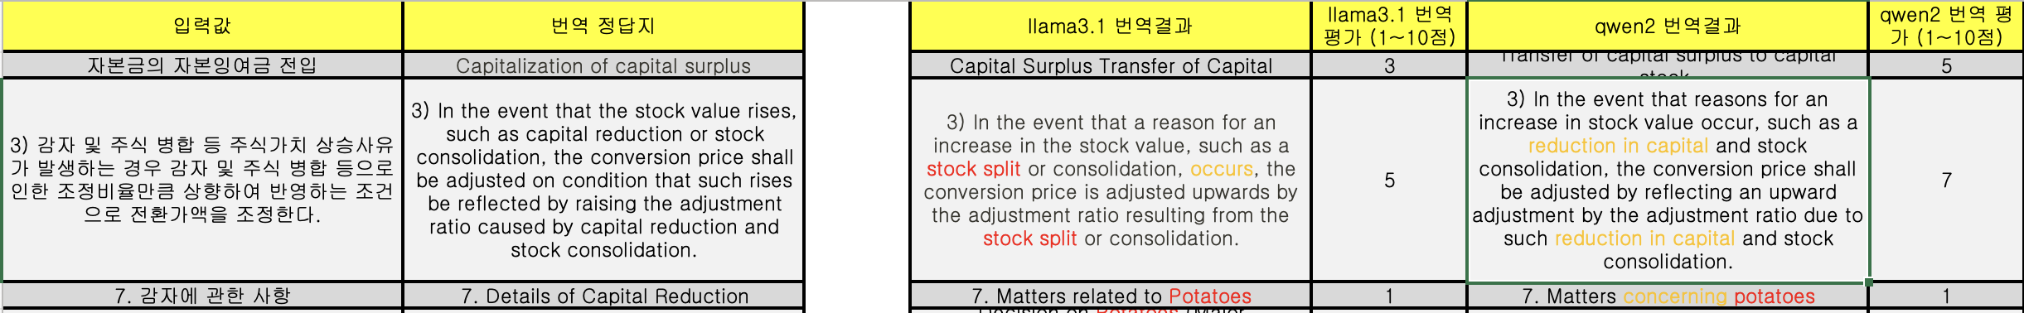
LLM 선정 근거_실성능 추가 비교
개요
방법
결과
Llama3.1 - 70B, Qwen2 - 72B 두 모델의 성능 우위를 판별하기 어려워, 20개의 추가예시 번역결과에 대한 정성평가 실시
20개 예시를 선정하여 각 모델의 변역결과를 저장
각 모델의 번역 결과에 번역가의 주관적인 점수(1 ~ 10) 부여
점수 평균 계산
Llama3.1 – 70B: 4.75 점
Qwen2 – 72B: 4.8 점
예시

Slide 8
LLM 선정 근거_실성능 추가 비교
Input | GT | Llama3.1-70B | Qwen2-72B
23.09.12 주식소각결정을 통해 23.09.25일 167,406주에 대해 주식 소각(이익소각)을 진행하였습니다. | Through the September 12, 2023 Decision on Retiring Stocks, the company carried out stock retirement (profit retirement) for 167,406 shares on September 25, 2023. | 23.09.12 A decision was made to cancel shares, and on 23.09.25, 167,406 shares were cancelled (treasury shares cancellation). | 23.09.12 Through a decision to burn shares, we proceeded with the burning of 167,406 shares on 23.09.25. (Profit burn). Please note, the term "profit burn" is a direct translation of the Korean term "이익소각" which is not a standard term in English financial contexts. In most cases, "share burn" or "share cancellation" might be more appropriate depending on the context. However, per your instruction, I've provided a direct translation.

Slide 9
LLM 선정 근거_실성능 추가 비교
Input | GT | Llama3.1-70B | Qwen2-72B
23.09.12 주식소각결정을 통해 23.09.25일 167,406주에 대해 주식 소각(이익소각)을 진행하였습니다. | Through the September 12, 2023 Decision on Retiring Stocks, the company carried out stock retirement (profit retirement) for 167,406 shares on September 25, 2023. | 23.09.12 A decision was made to cancel shares, and on 23.09.25, 167,406 shares were cancelled (treasury shares cancellation). | 23.09.12 Through a decision to burn shares, we proceeded with the burning of 167,406 shares on 23.09.25. (Profit burn). Please note, the term "profit burn" is a direct translation of the Korean term "이익소각" which is not a standard term in English financial contexts. In most cases, "share burn" or "share cancellation" might be more appropriate depending on the context. However, per your instruction, I've provided a direct translation.

Slide 10
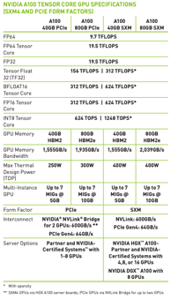
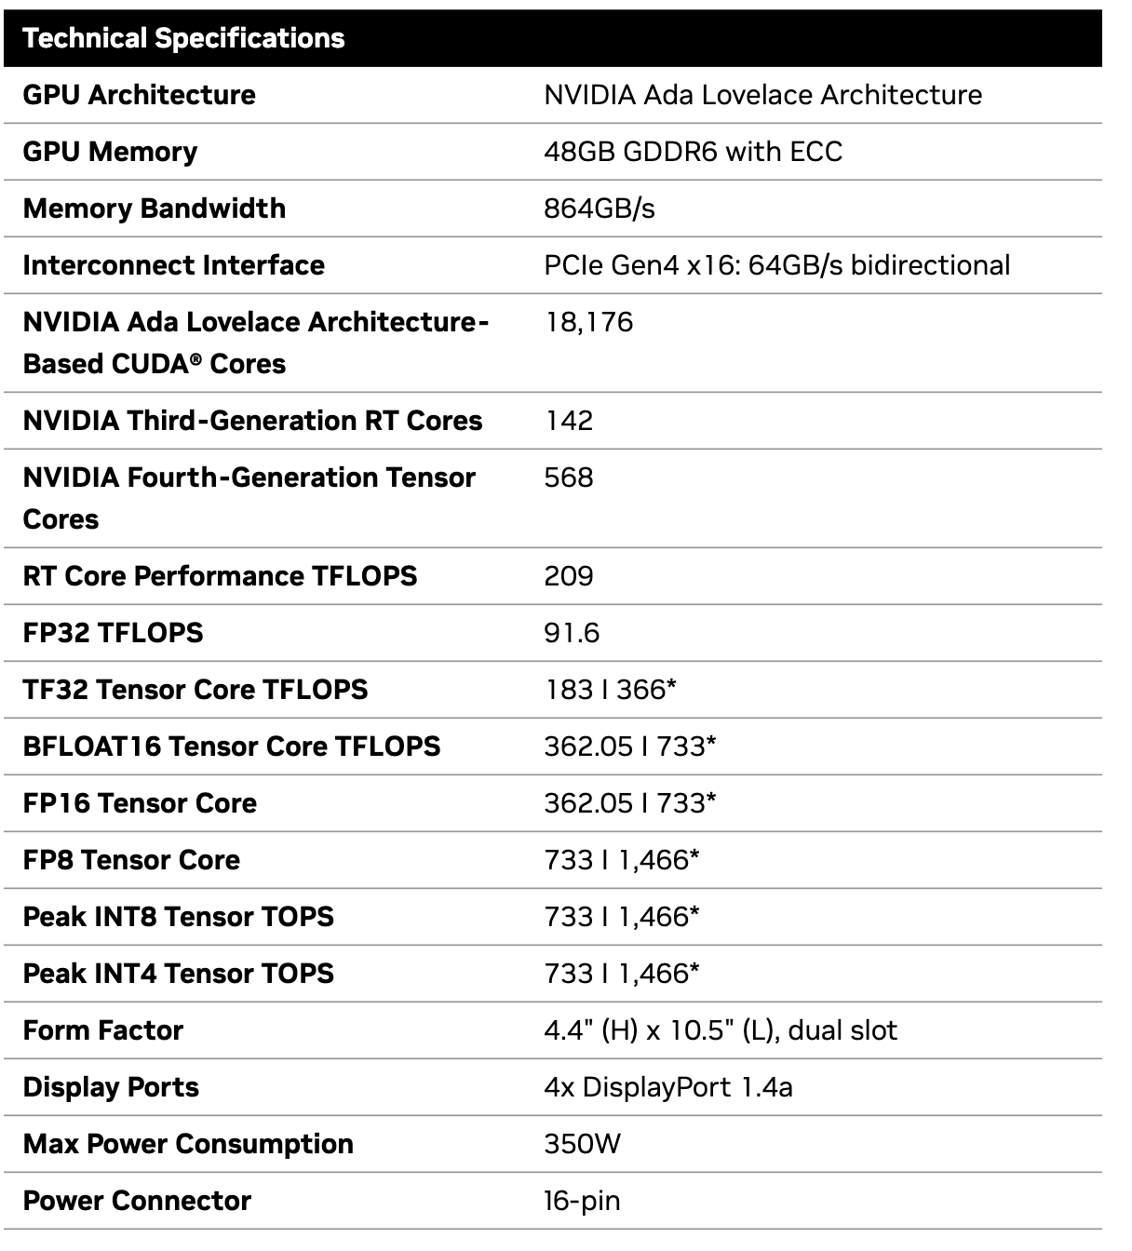
GPU 선정 근거
A100
L40S
연산능력(FP16 기준): 312 TFLOPS
GPU Memory: 40GB / 80 GB
가격: 40GB: 1,000만원 80GB: 3,500만원
연산능력(FP16 기준): 362 TFLOPS
GPU Memory: 48GB
가격: 1,050만원

Slide 11
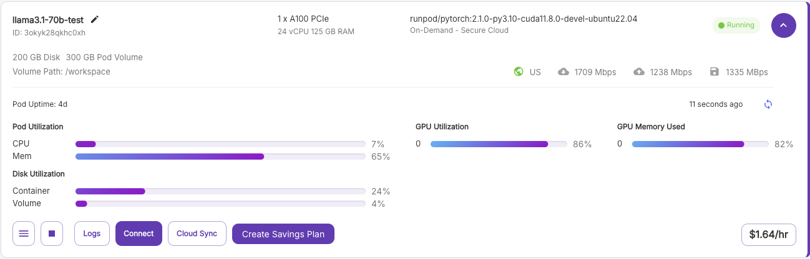
Hardware 선정 근거
Fine-tuning
Hyper parameter
Per_device_train_batch_size = 32
Gradient_accumulation_steps = 4
Data = 370k financial dataset

